Slide 1

Heart Disease Diagnostic Analysis

Slide 2
Introduction
My name is Deepak Gupta and I am work in Unified Mentor Pvt. Ltd. as a Data Scientist intern. I am select this project during the internship because I feel this is a very interesting project for learn something new skills for my future. This project is related to Healthcare domain.
This project predicts people with cardiovascular disease by extracting the patient medical history that leads to a fatal heart disease from a dataset that includes patients’ medical history such as chest pain, sugar level, blood pressure, etc. Heart failure occurs when the heart muscle doesn’t pump blood as well as it should. Blood often backs up and causes fluid to build up in the lungs and in the legs. The fluid buildup can cause shortness of breath and swelling of the legs and feet.
Coronary artery disease is a common heart condition that affects the major blood vessels that supply the heart muscle. Cholesterol deposits (plaques) in the heart arteries are usually the cause of coronary artery disease. The buildup of these plaques is called atherosclerosis.

Slide 3
Project Details
Project Title | Heart Disease Diagnostic Analysis
Technologies | Data Science
Domain | Healthcare
Project Difficulties Level | Intermediate
Tools | Python (Jupiter Notebook), Microsoft PowerBI, Microsoft Power Point, and Microsoft Excel

Slide 4
Objective of the Project
The objective of a heart disease diagnostic analysis project is to analyze heart disease occurrence based on a combination of features that describe the disease. The project may also aim to:-
Predict Heart Disease
Identify Risk Factors
Recommend a prediction System
The objective is to accurately identify individuals at high risk of heart attacks so healthcare providers can intervene early through prevention and treatment. The model achieves 86% accuracy in differentiating those likely to experience a heart attack from those not likely.

Slide 5
Problem Statement
Health is real wealth in the pandemic time we all realized the brute effects of covid-19 on all irrespective of any status. You are required to analyze this health and medical data for better future preparation.
Do ETL: Extract- Transform and Load data from the heart disease diagnostic database.
You can perform EDA through python. The database extracts various information such as Heart disease rates, Heart disease by gender, by age.
You can even compare attributes of the data set to extract necessary information. Make the necessary dashboard with the best you can extract from the data. Use various visualization and features and make the best dashboard .
Find key metrics and factors and show the meaningful relationships between attributes.

Slide 6
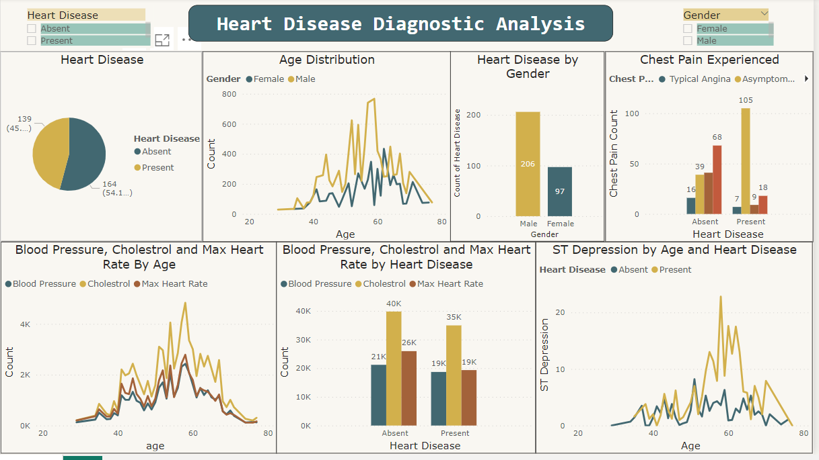
Overview of the Project

Slide 7
Some Important Insights of the Project
Heart disease and stoke can result in poor quality of life, disability, and death. Though both diseases are common, they can often be prevented by controlling risk factors like high blood pressure and high cholesterol through treatment.
Heart disease can be a silent condition, meaning you may not have any symptoms until you have a serious health problem, such as a heart attack or cardiac arrest. Having regular checkup is important to help your healthcare provider know your risk and recommend healthy lifestyle changes to prevent heart disease.
One of the best things you can do for your heart is to stop smoking or using smokeless tobacco. Even if you’re not a smoker, be sure to stay away from secondhand smoke. Chemicals in tobacco can damage the heart and blood vessels.

Slide 8
Learnt things from this Project
The average heart is the size of a fist in an adult. Your heart will beat about 115000mtimes each day. Your heart pumps about 2000 gallons of blood every day. An electrical system controls the rhythm of your heart.
Below are six important facts about heart diseases you should know:-
A yearly flu shot can benefit your heart.
Spending time with friends and family can lower your heart attack risk.
Many heart attacks occur on Monday mornings.
Chewing an aspirin as soon as heart attack symptoms appear can limit heart damage.
Playing racket sports such as tennis and squash may protect against cardiac death.
Women under age 50 are two times more likely than men of the same age to die from a heart attack.

Slide 9
Conclusion of the Project
45.87% People suffering from heart disease.
Elderly Aged Men are more (50 to 60 years) and Females are more in 55 to 65 Years category.
Males are more prone to heart disease.
Elderly Aged People are more prone to heart disease.
People having asymptomatic chest pain have a higher chance of heart disease.
High number of cholesterol level in people having heart disease.
Blood Pressure increases between age of 50 to 60 and somehow continue till 70.
Cholesterol and maximum heart rate increasing in the age group of 50-60.
ST depression mostly increase between the age group of 30-40.

Slide 10
Thank You
Detailed Project Report Submitted by
Deepak Gupta

